Slide 1


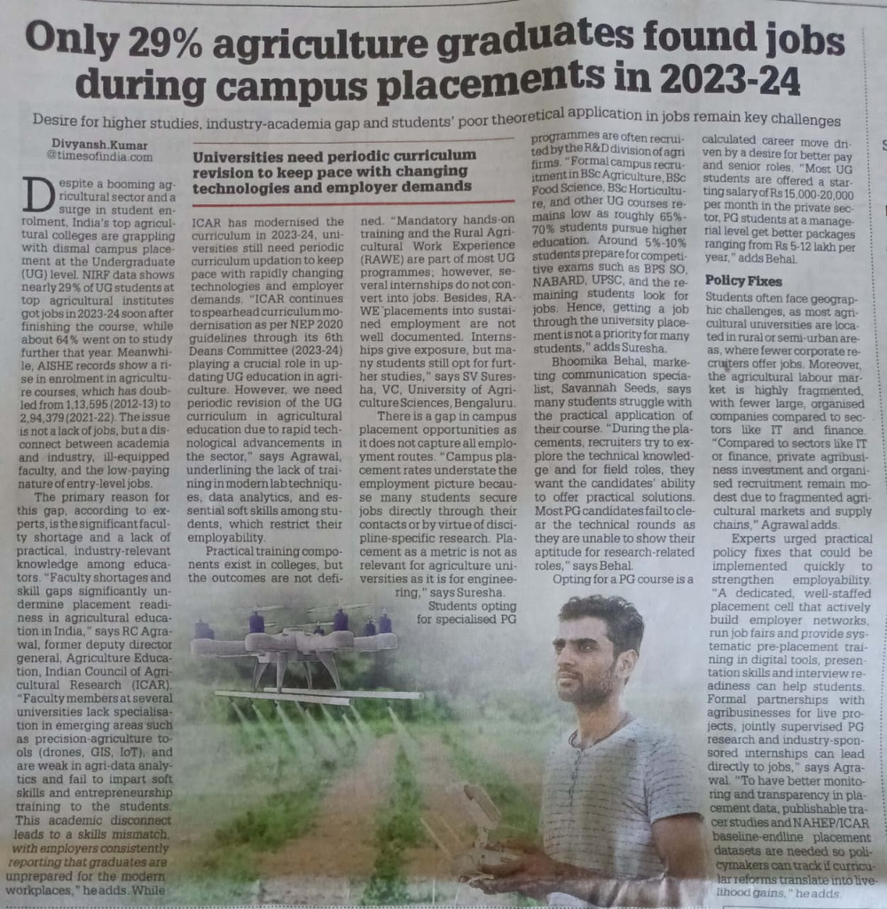

ARTICLE 2
THE TIMES OF INDIA
6 OCTOBER 2025

Slide 2


THE GRADUATE SKILLS GAP
The Problem
Statistic: Only 29% of graduates found jobs on campus.
Reason: A major disconnect between university curriculum and real-world job requirements.
Missing Skills: Data analytics, practical application, and soft skills.
The Solution
Modernize the curriculum.
Integrate with industry via internships and projects.
Target training on digital and soft skills.

